Slide 1
Filesystems

Slide 2
Múltiplos
Nome | Símbolo | Valor
quilo | k | 10³ = 1000¹
mega | M | 10⁶ = 1000²
giga | G | 10⁹ = 1000³
tera | T | 10¹² = 1000⁴
peta | P | 10¹⁵ = 1000⁵
exa | E | 10¹⁸ = 1000⁶
zetta | Z | 10²¹ = 1000⁷
yotta | Y | 10²⁴ = 1000⁸
Nome | Símbolo | Valor
kibi | Ki | 2¹⁰ = 1024¹
mebi | Mi | 2²⁰ = 1024² = 1 048 576
gibi | Gi | 2³⁰ = 1024³ = 1 073 741 824
tebi | Ti | 2⁴⁰ = 1024⁴ ≈ 1 099 × 10⁹
pebi | Pi | 2⁵⁰ = 1024⁵ ≈ 1 125 × 10¹²
exbi | Ei | 2⁶⁰ = 1024⁶ ≈ 1 152 × 10¹⁵
zebi | Zi | 2⁷⁰ = 1024⁷ ≈ 1 180 × 10¹⁸
yobi | Yi | 2⁸⁰ = 1024⁸ ≈ 1 208 × 10²¹

Slide 3
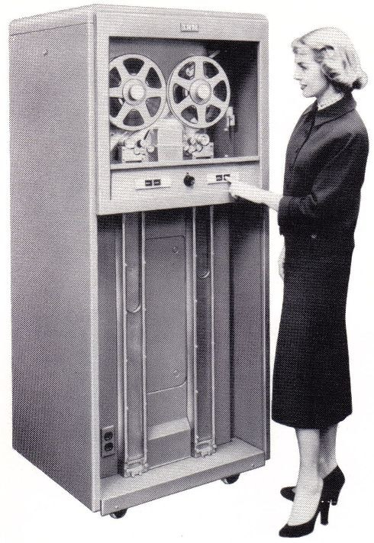
Tape
1950 - …
Acesso sequencial
Exemplos:
  Open reel-to-reel
    ½”
    9-track
  Closed
    ¼”
    SCSI tape
    video-8 (Exabyte)
    DAT (Digital Audio Tape)
    DLT (Digital Linear Tape)

Slide 4
tar command
tar = tape archive
  Create a tar archive (-c)
List files in a tar archive (-t)
  Extract files from a tar archive (-x)
  Copying directories and files using tar
# tar –cvf /dev/rmt0 /home
# tar -cvf /backup/home.tar /home
# tar –tvf /dev/rmt0
# tar –xvf /dev/rmt0
# cd /data
# tar –cf | (cd /data_backup && tar xBpf -)
Notes:
© Copyright IBM Corporation 2008
Notes:
The tar command archives and restored files. tar is most commonly used in tandem with an external compression utility, since it has no built-in data compression facilities.
Here is a list of the commonly use options:
-c create a tar backup
-x extract (restore) a file(s) from a tar file
-t reads the content of the tar file (verify the backup)
-v verbose output - displays files as they are backed up and restored
-f identify the file or device holding the tar image
-h follow symbolic links
-u appends files to an existing archive
-p preserves file permissions, ignoring the present umask value.
-B forces a consistent blocking factor. This will help ensure this copy is made correctly.
The final .tar file is usually called a referred to as a tarball.
The -h flag will cause tar to follow symbolic links as if they were normal files or directories.
Often, when an archive is created, some additional files need to be copied to it. The -u flag appends files to an existing archive.
Transition statement — Let's discuss the cpio command.

Slide 5
cpio command
cpio = copy in and out
  Create a cpio backup (-o)
List files in a cpio backup (-t)
Extract files from a cpio backup (-i)
Copy the contents of the current location to /mydir
# find /home | cpio –ov > /backup/home.bk
# cpio -itv < /backup/home.bk
# cpio –idv < /backup/home.bk
# find . -depth | cpio -pd /mydir
Notes:
© Copyright IBM Corporation 2008
Notes:
cpio copies file archives in from or out to tape, disk or another location on the local machine.
Here is a list of the commonly use options:
-o command reads file path names from standard input and copies these files to standard output, along with path names and status information.
-i command reads from standard input an archive file created by the cpio -o command and copies from it the files with names that match the Pattern parameter.
-p copies files to another directory on the same system.
-d create directories as needed
-v verbose (print files)
Instructor notes:
Purpose — Explain how to use the cpio command.
Details — Explain the use of cpio and go through the examples provided.
Additional information — The tar command is much more widely used in Unix environments than cpio. Some applications, for example: Informix is packaged in cpio format.
Transition statement — Let's discuss the pax command.

Slide 6
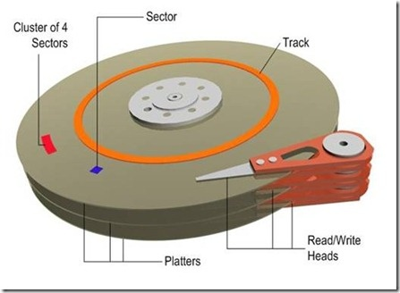
Disk

Slide 7
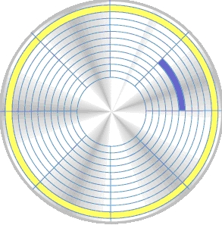
Track & Sector
Track / Pista
Sector
(Sector de pista)
(Sector)

Slide 8
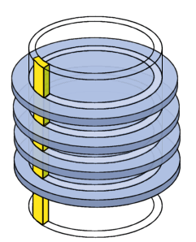
Cilindro
Conjunto de pistas de todas as cabeças

Slide 9
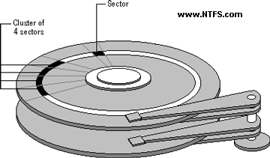
Clusters
A cluster, also known as an allocation unit, consists of one or more sectors of storage space, and represents the minimum amount of space that an operating system allocates when saving the contents of a file to a disk.
The number of sectors per cluster is dependent on
  Type of disk (floppy disk, hard disk)
  Version of operating systems
  Size of disk
Every sector contains 512 bytes.

Slide 10

LBA <-> CHS
LBA = ( CYL * HPC + HEAD ) * SPT + SECT – 1
LBA = (Cylinder * Heads_per_Cylinder + Head ) * Sectors_per_Track + Sector - 1
cylinder = LBA / (heads_per_cylinder * sectors_per_track)
temp = LBA % (heads_per_cylinder * sectors_per_track)
head = temp / sectors_per_track
sector = temp % sectors_per_track + 1

Slide 11
Disk Information: hdparm
# hdparm -i /dev/hdb
/dev/hdb:
Model=WDC WD1200JB-00CRA1, FwRev=17.07W18, SerialNo=WD-WMA8C4532865
Config={ HardSect NotMFM HdSw>15uSec SpinMotCtl Fixed DTR>5Mbs FmtGapReq }
RawCHS=16383/16/63, TrkSize=57600, SectSize=600, ECCbytes=40
BuffType=DualPortCache, BuffSize=8192kB, MaxMultSect=16, MultSect=off
CurCHS=16383/16/63, CurSects=16514064, LBA=yes, LBAsects=234441648
IORDY=on/off, tPIO={min:120,w/IORDY:120}, tDMA={min:120,rec:120}
PIO modes: pio0 pio1 pio2 pio3 pio4
DMA modes: mdma0 mdma1 mdma2
UDMA modes: udma0 udma1 udma2 udma3 udma4 *udma5
AdvancedPM=no WriteCache=enabled
Drive conforms to: device does not report version:
* signifies the current active mode

Slide 12
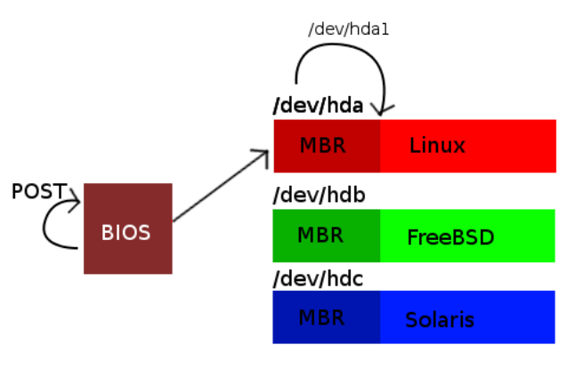
Disk Devices

Slide 13
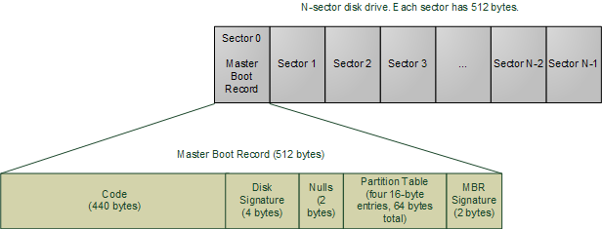
MBR
Master Boot Record

Slide 14
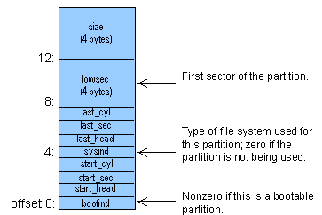
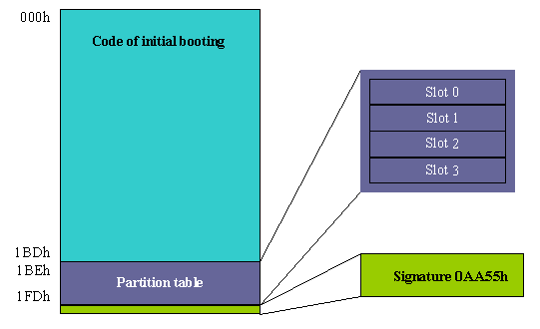
Partition Table
MBR

Slide 15
fdisk
Command (m for help): m
Command action
a toggle a bootable flag
b edit bsd disklabel
c toggle the dos compatibility flag
d delete a partition
l list known partition types
m print this menu
n add a new partition
o create new empty DOS partition table
p print the partition table
q quit without saving changes
s create a new empty Sun disklabel
t change a partition's system id
u change display/entry units
v verify the partition table
w write table to disk and exit
x extra functionality (experts only)
Partition table manipulator for Linux
fdisk [-options] device
device:
/dev/hda
/dev/hdb
/dev/sda
/dev/sdb
…
# /sbin/fdisk /dev/sdb
Command (m for help): p
Disk /dev/sdb: 1031 MB, 1031798784 bytes
32 heads, 62 sectors/track, 1015 cylinders
Units = cylinders of 1984 * 512 = 1015808 bytes
Device Boot Start End Blocks Id System
/dev/sdb1 * 1 11 10881 e W95 FAT16 (LBA)
/dev/sdb2 12 200 187488 83 Linux

Slide 16
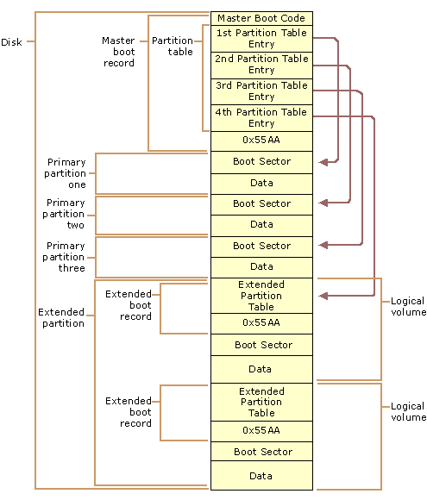
Disk

Slide 17
Partition Table Big Problem
Partition Table in MBR:
32-bit pointers for LBA (Logical Block Addressing)
Sectors are assumed to be 512 bytes long
512 * 2³² = 2⁴¹
Maximum disk size is ~2.2 TB (2 TiB) !!

Slide 18
MBR / Partition Table
Problems:
  2³² sector limit
  Single Point Of Failure (SPOF) – one copy
  Maximum four primary partitions
  Extended/Logical partitions are lame and fragile (Single-linked list!)

Slide 19
GUID Partition Table (GPT)
    A newer way to partition disks:
    Part of Unified Extensible Firmware Interface (UEFI) approach
Up to 2⁶⁴ sectors (8 Giga-Terabytes [ZiB])
Two copies; start and end of disk
Variable number of partitions (default 128).
LBA 0 is a "Protective MBR“
  a dummy partition table with one partition of type 0xEE covering whole disk (up to a maximum of 2 TiB)
    OSes which cannot read GPT: unknown partition, no space
    GPT-aware OSes: check the “GPT partition table”

Slide 20
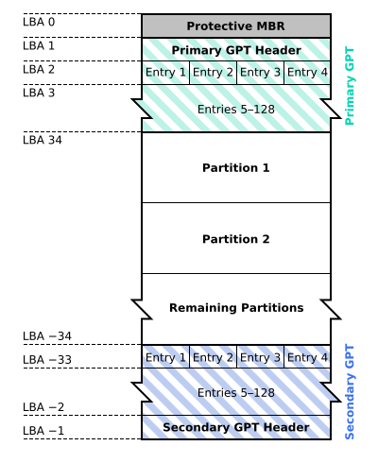
GUID Partition Table Scheme

Slide 21
GPT
LBA 1 is GPT header
Defines
  Maximum number of partitions
  Number and size of table entries
  Disk UUID
  Location of GPT, backup GPT
  Checksums
GPT entries include
  64-bit start LBA and end LBA (not length)
  128-bit UUID for partition type
  Name (up to 36 UTF-16LE "code units")

Slide 22
GUID Partition Table Header
Partition header table (LBA 1):
Offset | Length | Contents
0 | 8 bytes | Signature ("EFI PART", 45 46 49 20 50 41 52 54)
8 | 4 bytes | Revision (For GPT version 1.0 through at least UEFI version 2.3.1), the value is 00 00 01 00)
12 | 4 bytes | Header size in little endian (in bytes, usually 5C 00 00 00 meaning 92 bytes)
16 | 4 bytes | CRC32 of header (0 to header size), with this field zeroed during calculation
20 | 4 bytes | Reserved; must be zero
24 | 8 bytes | Current LBA (location of this header copy)
32 | 8 bytes | Backup LBA (location of the other header copy)
40 | 8 bytes | First usable LBA for partitions (primary partition table last LBA + 1)
48 | 8 bytes | Last usable LBA (secondary partition table first LBA - 1)
56 | 16 bytes | Disk GUID (also referred as UUID on UNIXes)
72 | 8 bytes | Partition entries starting LBA (always 2 in primary copy)
80 | 4 bytes | Number of partition entries
84 | 4 bytes | Size of a partition entry (usually 128)
88 | 4 bytes | CRC32 of partition array
92 | * | Reserved; must be zeroes for the rest of the block (420 bytes for a 512-byte LBA)

Slide 23
UUIDs
Universally Unique IDentifiers
  128-bit numbers written as 32 hex digits.
  3.4 × 10³⁸ possible UUIDs
Used to identify devices on Linux
  To find UUID for a specific device:
  vol_id –u /dev/sda1
  All devices: ls –l /dev/disk/by-uuid
# /etc/fstab
#
# <file system> <mount point> <type> <options>
UUID=fbdfebe2-fbde-42c9-963d-12428b642f1d / ext3 defaults 0 1
UUID=a1858e04-78b9-460b-a6cb-3f1dfe3fa16e /home ext3 defaults 0 2
UUID=c4f14e27-96cd-420c-9860-4bd5298e3f76 none swap sw 0 0

Slide 24
GPT Partition Entries
Partition Entries (LBA 2 .. 33)
  128 bytes for each partition entry
Offset | Length | Contents
0 | 16 Bytes | Partition type GUID
16 | 16 Bytes | Unique partition GUID
32 | 8 Bytes | First LBA (little-endian)
40 | 8 Bytes | Last LBA (inclusive, usually odd)
48 | 8 Bytes | Attribute flags (e.g. bit 60 denotes read-only)
56 | 72 bytes | Partition name (36 UTF-16LE code units)
 | 128 Bytes | Total

Slide 25
GPT howto
Don't use old fdisk; it's for MBR-only disks
Old fdisk warns if it detects a GPT-labeled disk
Recent fdisk supports GPT.
  g create a new empty GPT partition table
  o create a new empty DOS partition table
  …

Slide 26
GPT with fdisk
g create a new empty GPT partition table
o create a new empty DOS partition table
…

Slide 27
Basic parted
  mklabel gpt # create the disklabel
  p # list the GPT partitions
  q # exit parted, writing changes
  mkpart <name> <start> <end>
  # creates a basic data partition
  # e.g. mkpart home 1G 2G
  mkpart <name> linux-swap <start> <end>
  # creates a swap partition
  # e.g. mkpart swap linux-swap 2G 3G

Slide 28
Basic parted (continued)
Create a software RAID partition
  Make a normal data partition
  Mark as RAID:
    parted /dev/sda set 3 raid on
    (Marks /dev/sda3 with "Linux RAID" GUID)

Slide 29
dd
Data Duplicator
Can be used with files, devices, memory and ports.
Useful command parameters:
  of=ofile write to ofile (or device) instead of stdout
  if=ifile read from ifile instead of stdin
  bs=size specify block size (also ibs and obs)
  count=n copy just n blocks
  skip=offset start at position offset blocks
# dd if=/dev/nst0 of=/tmp/ibm.tape bs=4095 count=4
Notes:
The dd command makes images of disks.
To make image of entire disk /dev/hda to a file:
dd if=/dev/hda of=/mnt/hda_backup.dd
To tape:
dd if=/dev/hda of =/dev/nst0
To make an image of one partition:
dd if=/dev/hda1 of=/hda1_img.dd

Slide 30
dd - Example
Create file system image
Restore filesystem from image
Copy physical memory to file
# dd if=/dev/sda1 of=mypart.img
# dd if=mypart.img of=/dev/sda1
# dd if=/dev/mem of=mymemory.bin bs=1k skip=412 count=43
Notes:
The answers to this exercise are provided at the end of this chapter.

Slide 31
List devices and partitions
cat /proc/partitions
  major minor #blocks name
  8 0 488386584 sda
  8 1 5496832 sda1
  8 2 482888704 sda2
lsblk
  NAME MAJ:MIN RM SIZE RO TYPE MOUNTPOINT
  sda 8:0 0 465.8G 0 disk
  ├─sda1 8:1 0 5.2G 0 part [SWAP]
  └─sda2 8:2 0 460.5G 0 part /
  sr0 11:0 1 1024M 0 rom
fdisk -l

Slide 32
Booting from GPT
All current Linux distros can use GPT-labeled secondary disks
To boot from GPT, your system must support the uEFI boot process
The "Protective MBR" no longer contains bootloader
First partition on boot disk is EFI System Partition (ESP) – a FAT filesystem, usually mounted on /boot/efi
See also efibootmgr

Slide 33
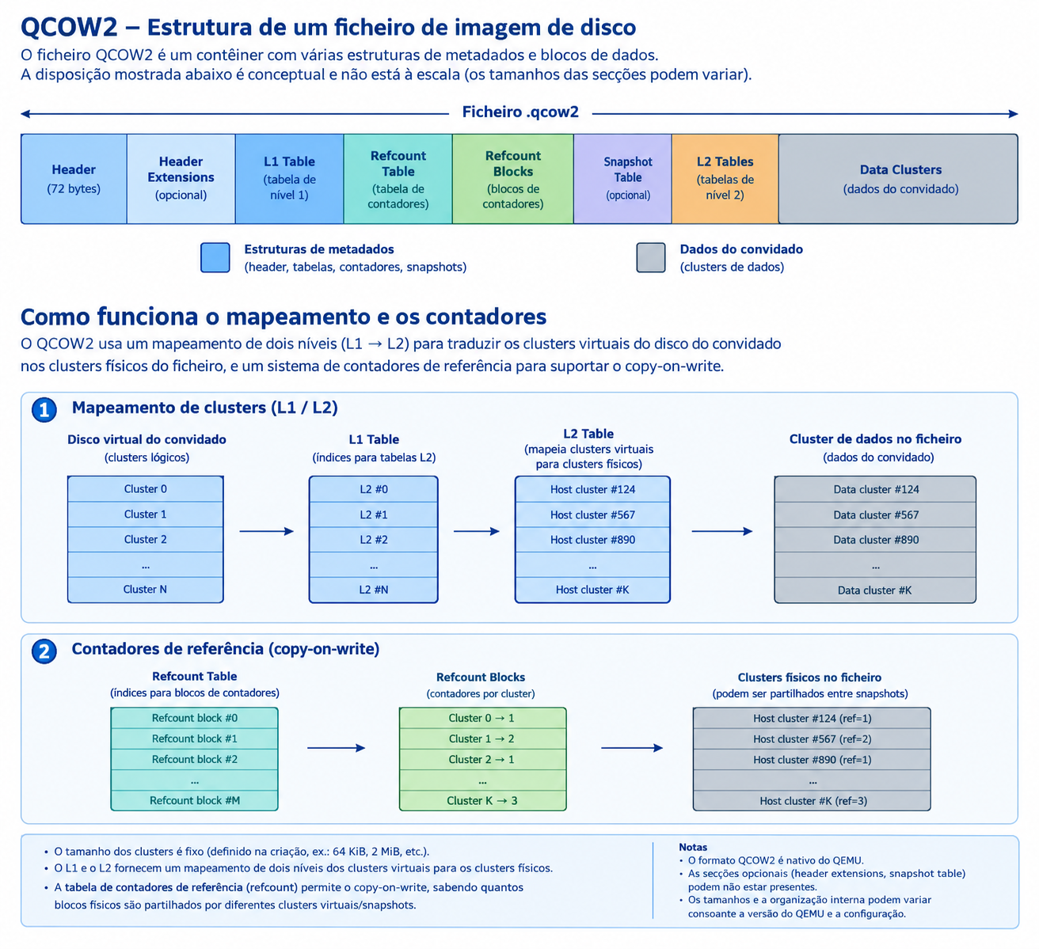
Imagens QCOW2
Dimensão do Data Cluster: 64KiB – 2MiB

Slide 34
Imagens QCOW2
Criar imagem QCOW2:
qemu-img create -f qcow2 disk.qcow2 100G
Inspecionar disco qcow2:
qemu-img info disk.qcow2
Converter disco para RAW (extrair):
qemu-img convert -f qcow2 -O raw disk.qcow2 disk.raw

Slide 35
File System
In a storing device, information is localized by its address (ex: LBA)
  Difficult to remember and to identify.
  Can be hard to expand a data block.
Solution: File System
  Information is organized into files.
  Files are identified by its name.
  Files can be grouped into folders / directories.
  Needs a file allocation system:
    FAT, FAT32, NTFS, EXT, …

Slide 36
mkfs
Makes a file system
mkfs [ -V ] [ -t fstype ] [ fs-options ] filesys [ blocks ]
Examples
mkfs -t vfat /dev/sda1
mkfs -t ext3 /dev/sdb3
mkfs -t ext2 part.img
mkfs.vfat disc.img
mkfs.ext2 /dev/hda1
mke2fs /dev/sda2

Slide 37
mount
Mount filesystem in dir:
$ mount /dev/hda2 /new/subdir
Unmount filesystem:
$ umount /dev/hda2
or
$ umount /new/subdir
List all mounted file systems:
$ mount
Remount a partition with specific options:
$ mount -o remount,rw /dev/hda2
Mount a filesystem image file:
$ mount -o loop ~/disks/dvd-image.iso /media/dvd

Slide 38
Mounting
To use a filesystem
  mount /dev/sda1 /mnt
  df /mnt
Automatic mounting
  Add an entry in /etc/fstab
  mount –a
Unmount
  umount /dev/sda1
  Cannot unmount a volume in use.

Slide 39
fstab
# /etc/fstab
#
# <file system> <mount point> <type> <options>
proc /proc proc defaults 0 0
/dev/hdc1 / ext3 defaults 0 1
/dev/hdc5 /win vfat user,rw 0 0
/dev/hdc7 none swap sw 0 0
/dev/hdc8 /var ext3 defaults 0 2
/dev/hdc9 /home ext3 defaults 0 2
/dev/hda /media/cdrom0 iso9660 ro,user 0 0
/dev/fd0 /media/floppy0 auto rw,user 0 0

Slide 40
df
df : Disk Free
reports the amount of available disk space being used by mounted file systems.
Example:
[xxxxx@ave ~]$ df
Filesystem 1K-blocks Used Available Use% Mounted on
rootfs 475310184 341312864 109852888 76% /
devtmpfs 1950820 0 1950820 0% /dev
tmpfs 1960864 0 1960864 0% /dev/shm
tmpfs 1960864 47664 1913200 3% /run
/dev/sda2 475310184 341312864 109852888 76% /
tmpfs 1960864 47664 1913200 3% /run
tmpfs 1960864 0 1960864 0% /sys/fs/cgroup
tmpfs 1960864 0 1960864 0% /media

Slide 41
Adding a Disk
Install new hardware
  Verify disk recognized by BIOS.
Boot
  Verify device exists in /dev
Partition
  fdisk /dev/sdb
  or
  parted /dev/sdb
Create filesystem
  mkfs –v –t ext3 /dev/sdb1
Add entry to /etc/fstab
  /dev/sdb1 /proj ext3 defaults 0 2
Mount new FS
mount -a

Slide 42
fsck: check + repair fs
Filesystem corruption sources:
  Power failure
  System crash
Types of corruption:
  Unreferenced inodes.
  Bad superblocks.
  Unused data blocks not recorded in block maps.
  Data blocks listed as free that are used in files.
fsck can fix these and more
  Asks user to make more complex decisions.
  Stores unfixable files in lost+found.

Slide 43
Windows Filesystems
DRIVE SIZE | FAT 16 Cluster Size | FAT 32 Cluster Size | NTFS Cluster Size
260 to 511 MB | 8 KB (16 sectors) | Not Supported | 512 bytes (1 sector)
512 to 1023 MB | 16 KB (32 sectors) | 4 KB (8 sectors) | 1KB (2 sectors)
1024 MB to 2 GB | 32 KB (64 sectors) | 4 KB (8 sectors) | 2 KB (4 sectors)
2 to 4 GB | 64 KB (128 sectors) | 4 KB (8 sectors) | 4 KB (8 sectors)
4 to 8 GB | Not Supported | 4 KB (8 sectors) | 8 KB (16 sectors)
8 to 16 GB | Not Supported | 8 KB (16 sectors) | 16 KB (32 sectors)
16 to 32 GB | Not Supported | 16 KB (32 sectors) | 32 KB ( 64 sectors)
>32 GB (up to 2 TB) | Not Supported | 32 KB (64 sectors) | 64 KB (128 sectors)

Slide 44
OS and File System Compatibility
Operating System | FAT16 | FAT32 | NTFS
Windows XP | ☑ | ☑ | ☑
Windows 2000 | ☑ | ☑ | ☑
Windows NT | ☑ |  | ☑
Windows 95, 98, ME | ☑ | ☑
Windows 95 | ☑
MS-DOS | ☑

Slide 45
OS and File System Compatibility
Operating System | FAT16 | FAT32 | NTFS | exFAT
Windows 7, 8, 10, 11 | ☑ | ☑ | ☑ | ☑
Windows XP | ☑ | ☑ | ☑ | ☑
Windows 2000 | ☑ | ☑ | ☑ | ☑
Windows NT | ☑ |  | ☑ | ☑
Windows 95, 98, ME | ☑ | ☑
Windows 95 | ☑
MS-DOS | ☑

Slide 46
exFAT
Optimized for flash memory (USB flash drives and SD cards)
Potential capacity to 64 ZiB
  Current support ≈ 128 PiB
Sector sizes from 512 to 4096 bytes
Clusters sizes to 32MiB
Subdirectories to 256MiB
Built for speed, less overhead than NTFS
UTC Timestamp Support
12 sector VBR, support of large boot program
Up to 2,796,202 files per subdirectory
File Names max to 255 Characters
Unicode File Names and Volume Labels

Slide 47
Linux development
Linux: first developed on a minix system
Both OSs shared space on the same disk
So, Linux reimplemented minix file system
Two severe limitations in the minixFS
  Block addresses are 16-bits (64MB limit)
  Directories use fixed-size entries (w/filename)

Slide 48
Extended File System
Ext: Extended File System
Originally written by Chris Provenzano
Extensively rewritten by Linux Torvalds
Initially released in 1992
Removed the two big limitations in minix
Used 32-bit file-pointers (filesizes to 2GB)
Allowed long filenames (up to 255 chars)

Slide 49
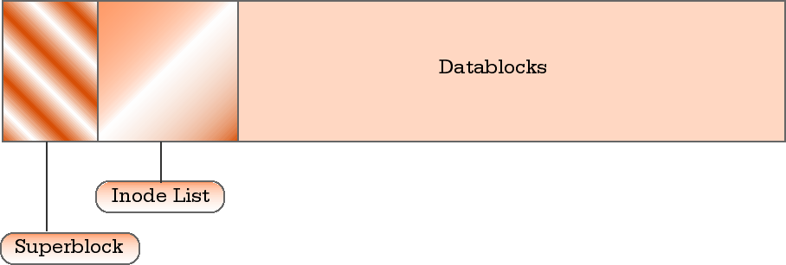
Unix filesystems concepts
Files are represented by inodes
Directories are special files (dentry lists)
Devices accessed by I/O on special files
UNIX filesystems can implement ‘links’

Slide 50
Inodes
A structure that contains file’s description:
  Type
  Access rights
  Owners
  Timestamps
  Size
  Pointers to data blocks
Kernel keeps the inode in memory (open)

Slide 51
Inode diagram
inode
File info
Direct blocks
Indirect blocks
Double
Indirect
Blocks

Slide 52
Directories
Directories are structured in a tree hierarchy
Each can contain both files and directories
A directory is just a special type of file
A directory contains a list of dentries.
Each dentry contains filename + inode-no
Special user-functions for directory access
Kernel searches the direrctory tree:
  translates a pathname to an inode-number

Slide 53
Directory diagram
Inode Table
Directory
inode 1
inode 2
inode 3
inode 4
i3
i2
i4
i1
name A
name B
name C
name D
dentry

Slide 54
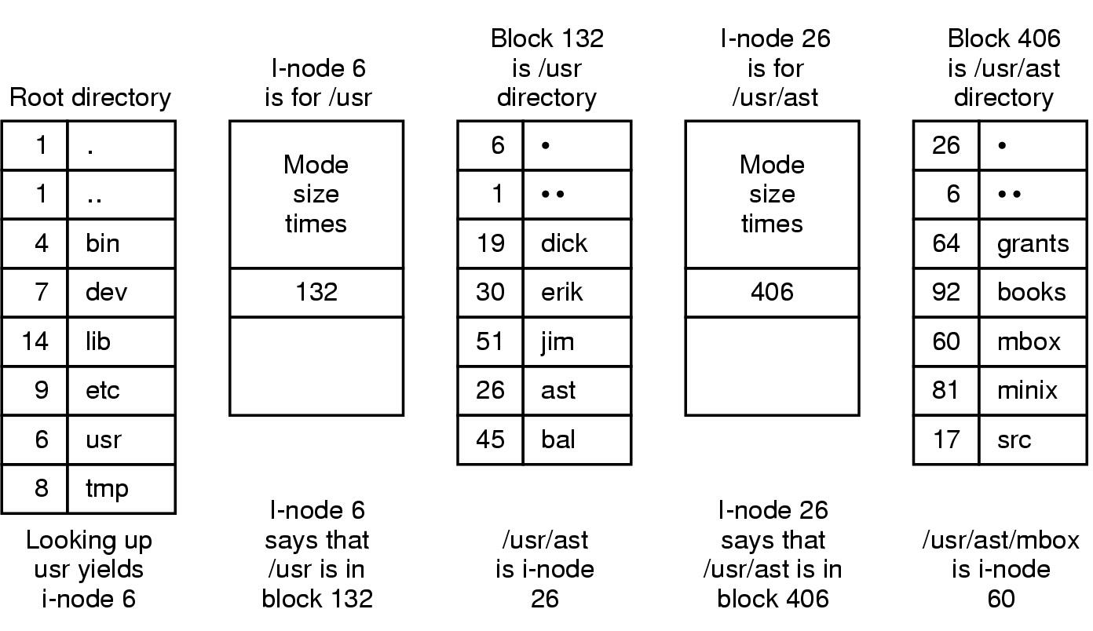
UNIX File System Example
Where is /usr/ast/mbox ?

Slide 55
Hard Links
Multiple names can point to same inode
The inode keeps track of how many links are set.
If a file gets deleted, the inode’s link-count gets decremented by the kernel.
File is deallocated if link-count reaches 0.
Hard links may exist only within a single FS.
Hard links cannot point to directories (cycles).
  ln src dest

Slide 56
Symbolic Links
Another type of file linkage (‘soft’ links)
Special file, consisting of just a filename
Kernel uses name-substitution in search
Soft links allow cross-filesystem linkage
But they do consume more disk storage
  ln –s src dest

Slide 57
Limitations in Ext
Some problems with the Extended file system
  Lacked support for 3 timestamps
    Accessed, Inode Modified, Data Modified
  Used linked-lists to track free blocks/inodes
    Poor performance over time
    Lists became unsorted
    Files became fragmented
  Did not provide room for future extensibility

Slide 58
Xia and Ext2 filesystems
Two new filesystems introduced in 1993
Both tried to overcome Ext’s limitations
Xia was based on existing minix code
Ext2 was based on Torvalds’ Ext code
Xia was initially smaller and more stable
But flaws in Ext2 were eventually fixed
Ext2 soon became a ‘de facto’ standard

Slide 59
Filesystem Comparison
MinixFS
Ext
XiaFS
Ext2
Maximal FS size
64MB
2GB
2GB
4TB
Maximal filesize
64MB
2GB
64MB
2GB
Maximal filename
14/30 chars
255 chars
248 chars
255 chars
3 timestamps
no
no
yes
yes
Extensible?
no
no
no
yes
Can vary block size?
no
no
no
yes
Code is maintained?
yes
no
?
yes

Slide 60
Traditional block filesystems
Can be left in a non-coherent state after a system crash
or sudden power-off.
Requires a full filesystem check after reboot.
ext2: traditional Linux filesystem
(repair it with fsck.ext2)
vfat: traditional Windows filesystem
(repair it with fsck.vfat on GNU/Linux
or Scandisk on Windows)

Slide 61
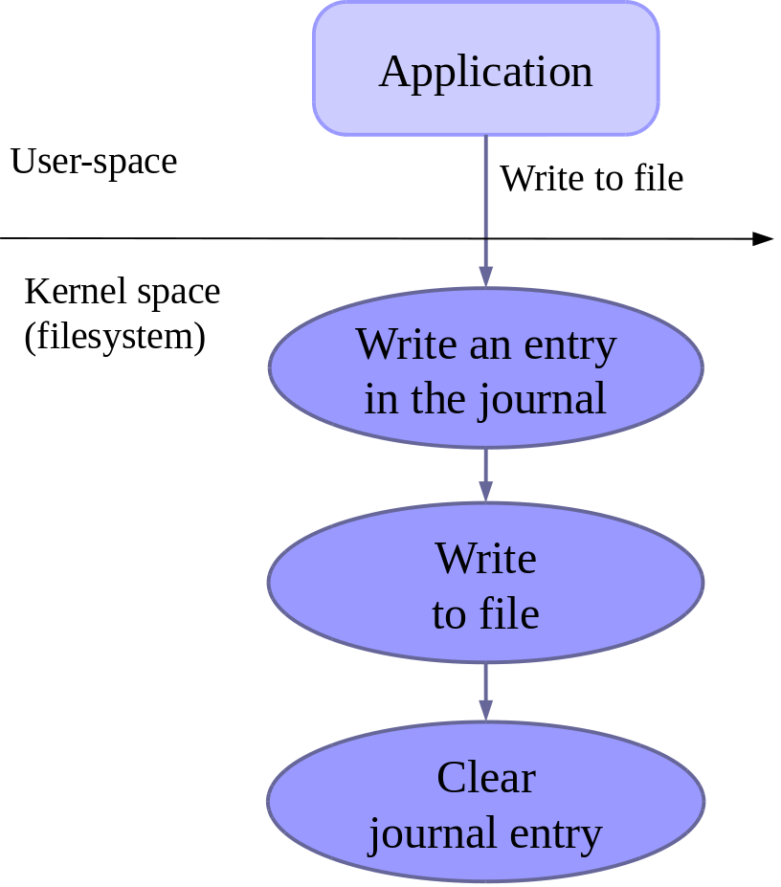
Journaled filesystems
Designed to stay in a correct state even after system crashes or a sudden power-off
All writes are first described in the journal before being committed to files

Slide 62
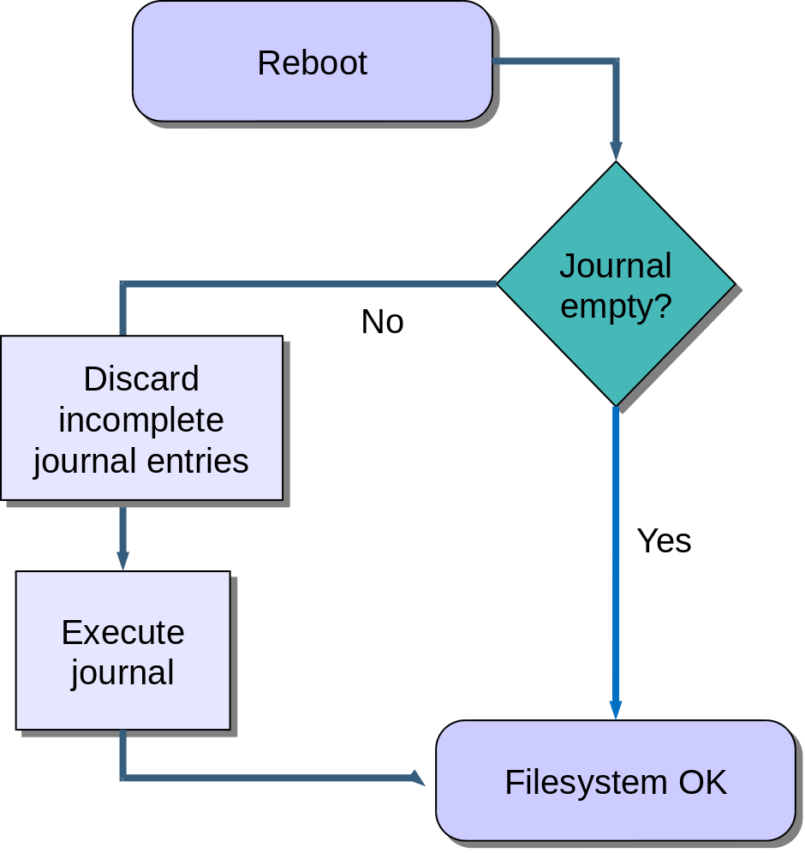
Filesystem recovery after crashes
Thanks to the journal,
the filesystem is never
left in a corrupted state.
Recently saved data
could still be lost.

Slide 63
Journaled block filesystems
ext3: ext2 with journal extension
ext4: the new generation with many improvements.
The Linux kernel supports many other filesystems: reiserFS, JFS, XFS, etc. Each of them have their own characteristics.
btrfs (“Butter FS”)
The next generation.

Slide 64
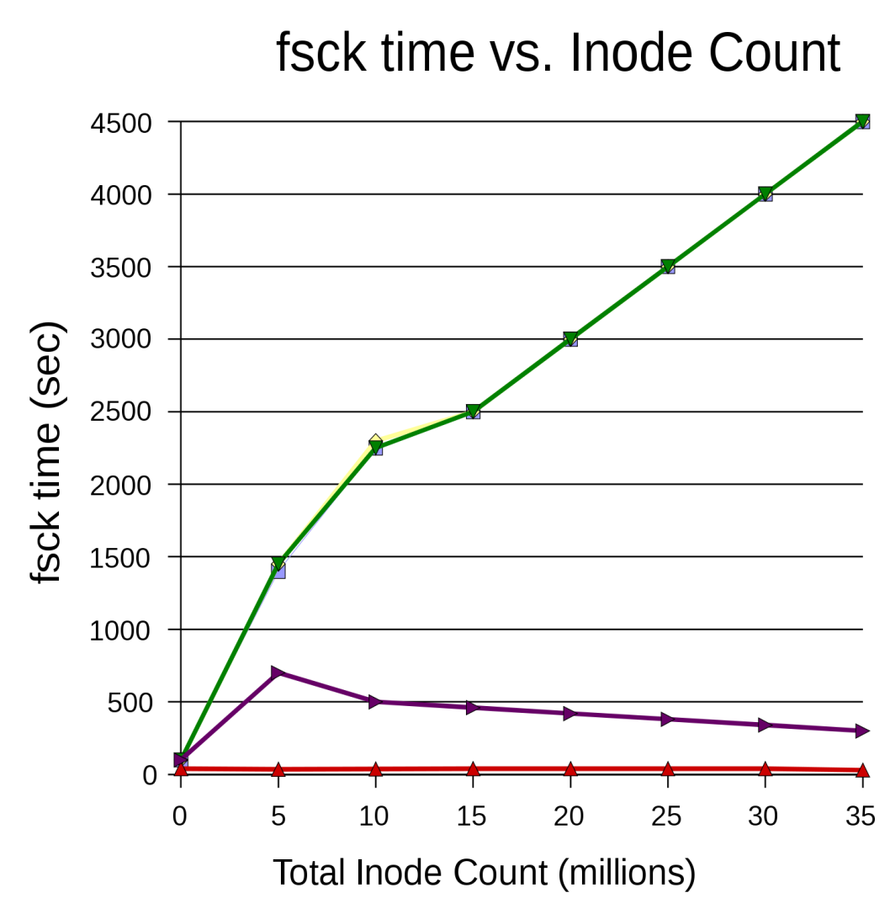
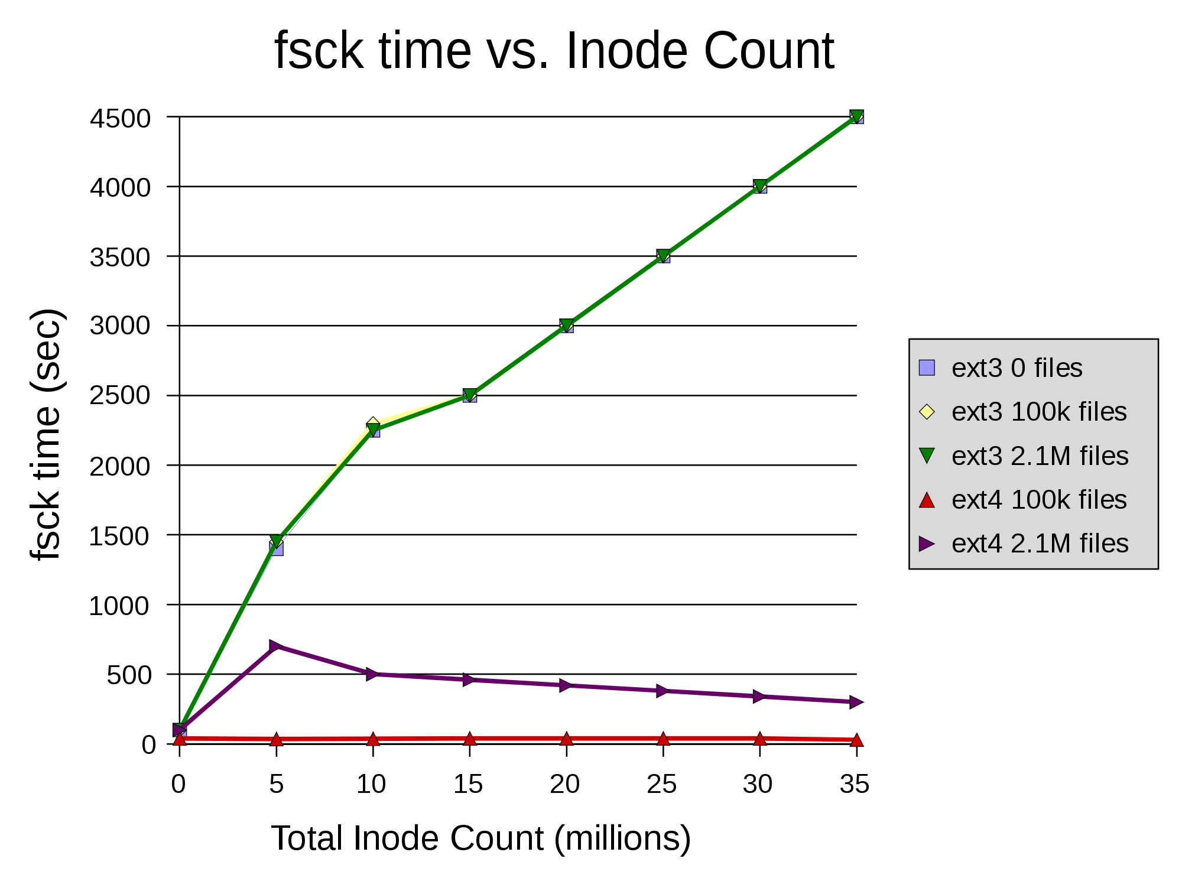
Ext4
2008
Até 1 EiB (2⁶⁰ Bytes)
Delayed Allocation
Timestamps em nanosegundo
Timestamps até 2038+204
FSCK mais rápido.

Slide 65
Squashfs
Squashfs: http://squashfs.sourceforge.net
Read-only, compressed filesystem for block devices.
Fine for parts of a filesystem which can be read-only (kernel, binaries...)
Great compression rate and read access performance
Used in most live CDs and live USB distributions
Supports LZO compression for better performance on embedded systems with slow CPUs (at the expense of compression rate)
Available in mainline Linux since version 2.6.29.
Patches available for all earlier versions.
Benchmarks: (roughly 3 times smaller than ext3, and 2-4 times faster)
http://elinux.org/Squash_Fs_Comparisons

Slide 66
LINUX RamDisk
A RAM disk is a filesystem in RAM (inverse concept of swap which is RAM on Disk).
RAM disks have fixed sizes and are treated like regular disk partitions.
Access time is much faster for a RAM disk than for a real, physical disk.
All RamDisk data is lost when the system is powered off and/or rebooted.
  mke2fs -m 0 /dev/ram0
  mkdir /mnt/rd0
  mount /dev/ram0 /mnt/rd0

Slide 67
tmpfs
Useful to store temporary data in RAM:
system log files, connection data, temporary files...
Don't use ramdisks! They have many drawbacks: fixed in size, Remaining space not usable as RAM, files duplicated in RAM (in the block device and file cache)!
tmpfs configuration: File systems -> Pseudo filesystems
Lives in the Linux file cache. Doesn't waste RAM: grows and shrinks to accommodate stored files. Saves RAM: no duplication; can swap out pages to disk when needed.
How to use: choose a name to distinguish the various tmpfs instances you could have. Examples:
mount -t tmpfs varrun /var/run
mount -t tmpfs udev /dev
See Documentation/filesystems/tmpfs.txt in kernel sources.

Slide 68
FS on Flash
Journals increase the number of writes.
atime updates drastically increase writes.
  Reduces Flash lifespan
Journals make many small writes.
atime updates requires many small writes.
  Reduces throughput (Flash uses block erasing)
Solutions: External Journal, no Journal, noatime, relatime, special FS

Slide 69
External Journal
ext4 can use another device to store the journal
mke2fs -O journal_dev /dev/ext_device
mkfs.ext4 -J device=/dev/ext_device /dev/main_dev
mount /dev/main_dev /mnt/mdir

Slide 70
FS para memórias Flash
Flash = EEPROM, apagável por blocos.
YAFFS – Yet Another Flash File System
  Usado no Android --2.2
JFFS / JFFS2 – Journaling Flash File System
UBIFS - Unsorted Block Image File System
LogFS

Slide 71
The Virtual File System idea
Multiple file systems need to coexist
But filesystems share a core of common concepts and high-level operations
So can create a filesystem abstraction
Applications interact with this VFS
Kernel translates abstract-to-actual

Slide 72
Virtual File System
Task 1
Task 2
…
Task n
user space
kernel space
VIRTUAL FILE SYSTEM
minix
ext2
msdos
proc
Buffer Cache
device driver
for hard disk
device driver
for floppy disk
Linux Kernel
software
hardware
Hard Disk
Floppy Disk

Slide 73
Virtual File Systems (VFS)
To support multitude of filesystems the operating system provides an abstraction called VFS or the Virtual Filesystem.
Kernel level interface to all underlying file systems into one format – in memory.
VFS receives system calls from user program (open, write, stat, link, truncate, close)
Interacts with specific filesystem (support code) at mountpoint.
VFS translates between particular FS format (local disk FS, NFS) and VFS data in memory.
Receives other kernel requests, usually for memory management.
Underlying filesystem is responsible for all physical filesystem management. User data, directories, metadata.

Slide 74
SWAP Space
RAM on Disk. Disk is 1 million times slower than RAM.
Ram utilization: top, vmstat, free
Show swap: swapon –s
In use: free –mt
Uses different area format – mkswap
And different partition type: 82
Turn on swap area with swapon, off with swapoff.
If low on virtual memory, can allocate temp swap space on an existing filesystem without reboot (see lab). But this is even lower performance than regular swap.
Can combine swap on filesystem with RamDisk on solid state drives for almost as good as memory performance. Why? Some OSes, software or hardware platforms have memory address limitations.

Slide 75
Network File System
Servidor
NFS
VFS
VFS
xFS
Cliente
NFS
xFS
RPC
RPC
Rede

Slide 76
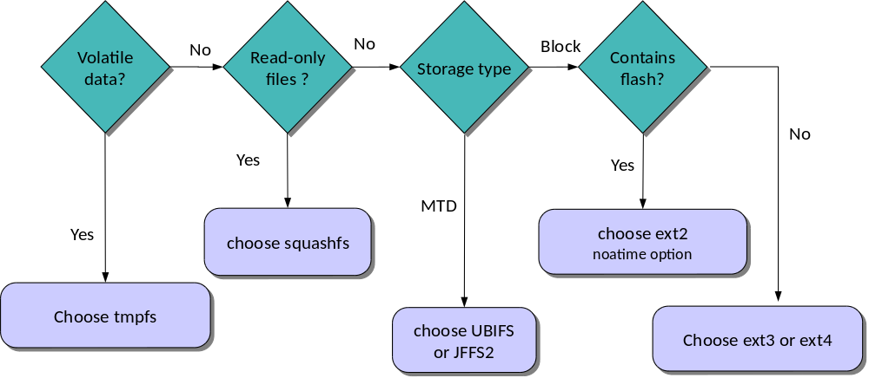
Filesystem choice summary
See Documentation/filesystems/ in kernel sources for details
about all available filesystems.

Slide 77
Mixing FS
A typical system requires different storing devices.
Each storing device provides its own file system.
Each file system is mounted on a specific directory.
Problem:
  How to group files from different devices in the same directory?
Solutions:
  Symbolic links (ln -s)
  UnionFS

Slide 78
ln -s
$ ln -s /tmp/tempfile mydir/tempfile
$ ln -s /mnt/cd/rofile mydir/rofile
$ ln -s /mnt/disk/rwfile mydir/rwfile
$ ls -l mydir
total 0
lrwxrwxrwx 1 jml users 14 Oct 30 17:25 rofile -> /mnt/cd/rofile
lrwxrwxrwx 1 jml users 16 Oct 30 17:25 rwfile -> /mnt/disk/rwfile
lrwxrwxrwx 1 jml users 13 Oct 30 17:25 tempfile -> /tmp/tempfile
$

Slide 79
UnionFS
File System Namespace Unification
Extension of VFS that merges the contents of two or more directories/filesystems.
Presents a unified view as a single mountpoint.
Combines one (or more) R/O or R/W base directory(s).
Any updates to the mountpoint are written to the overlay R/W directory/filesystem .
Typical uses:
Live CD merge RAMDisk with CDROM (LINUX, KNOPPIX).
Diskless NFS clients, Server Consolidation.
Available in:
    Sun TLS, BSD, MacOSx (from BSD), LINUX – funionfs(FUSE), aufs (SourceForge).
• UnionFS can be compiled into the kernel or installed with a separate product .
• When compiled into the kernel, unionfs shows up as a filesystem type under mount:
mount -t unionfs -o dirs=/dir1=rw:/dir2=ro none /mountpoint
• When installed separately in a product (funionfs under LINUX):
funionfs none -o dirs=/dir1=rw:/dir2=ro /mountpoint

Slide 80
Example UnionFS
User Process
User
Kernel
Virtual File System
UnionFS
RW
RW
RO
RO
TMPFS
SFS
NFS
Ext3

Slide 81
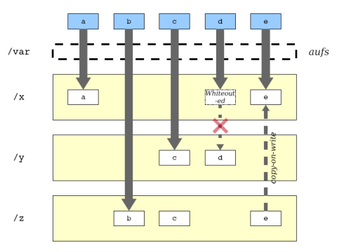
Aufs example
volatile
r/w
ro

Slide 82
Aufs example
mount /dev/sda1 /boot
mount -t squashfs myroot.sfs /root -o loop # Mount SFS RO
mount -t tmpfs -o size=30m tmpfs /root_rw # New RW FS
# Union SFS+TMP
mount -t aufs -o dirs=/root_rw:/root none /newroot
mount -t squashfs myroot.sfs /root -o loop # Mount SFS RO
mount -t tmpfs -o size=30m tmpfs /root_rw # New RW FS
mount -t ext3 /boot/config.ext3 /config # Mount ext3 FS
# Union SFS+TMP+EXT3
mount -t aufs -o dirs=/root_rw:/config:/root none /newroot

Slide 83
Volume Management
Traditionally, disk is exposed as a block device (linear array of blocks abstraction)
  Refinement: disk partitions = subarray within block array
Filesystem sits on partition
Problems:
  Filesystem size limited by disk size
  Partitions hard to grow & shrink
Solution: Introduce another layer – the Volume Manager (aka “Logical Volume Manager”)

Slide 84
Logical Volume Management
ext3
/home
ext2
/usr
jfs
/opt
filesystems
logical
volumes
LV1
LV2
LV3
VolumeGroup
physical
volumes
PV1
PV2
PV3
PV4
Volume Manager separates physical composition of storage devices from logical exposure

Slide 85
LVM Command-line tools
 | List | Display | Create | Resize | Remove
PV | pvs | pvdisplay | pvcreate | pvresize | pvremove
VG | vgs | vgdisplay | vgcreate | vgresize | vgremove
LV | lvs | lvdisplay | lvcreate | lvresize | lvremove

Slide 86
Setting up a LVG and LV
Create partitions
  fdisk /dev/hda
  fdisk /dev/hdb
Initialize physical volumes
  pvcreate /dev/hda2
  pvcreate /dev/hdb3
Initialize a volume group
  vgcreate arcom_vol1 /dev/hda2 /dev/hdb3
Create logical volumes
  lvcreate -n arcom1 --size 100G arcom_vol1
Create filesystem
  mkfs –v –t ext3 /dev/arcom_vol1/arcom1

Slide 87
Extending a LV
Set absolute size
  lvextend –L120G /dev/arcom_vol1/arcom1
Or set relative size
  lvextend –L+20G /dev/arcom_vol1/arcom1
Expand the filesystem without unmounting
  ext2online –v /dev/arcom_vol1/arcom1
Check size
  df –k

Slide 88
RAID
RAID: Redundant Arrays of Inexpensive Disks
Idea born around 1988
Original observation: it’s cheaper to buy multiple, small disks than single large expensive disk (SLED)
  SLEDs don’t exist anymore, but multiple disks arranged as a single disk still useful
Can reduce latency by writing/reading in parallel
Can increase reliability by exploiting redundancy
  “I” in RAID now stands for “independent” disks
Several arrangements are known, 7 have “standard numbers”
Can be implemented in hardware/software
RAID array would appear as single physical volume to LVM

Slide 89
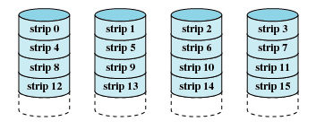
RAID 0
RAID: Striping data across disk
Advantage: If disk accesses go to different disks, can read/write in parallel → decrease in latency
Disadvantage: Decreased reliability:
MTTF(Array) = MTTF(Disk)/#disks

Slide 90
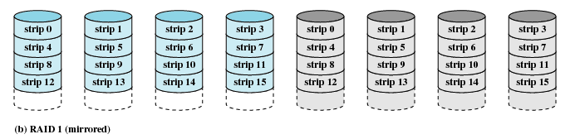
RAID 1
RAID 1: Mirroring (all writes go to both disks)
Advantages:
  Redundancy, Reliability – have backup of data
  Potentially better read performance than single disk – why?
  About same write performance as single disk
Disadvantage:
  Inefficient storage use

Slide 91
Using XOR for Parity
XOR | 0 | 1
0 | 0 | 1
1 | 1 | 0
Recall:
  X^X = 0
  X^1 = !X
  X^0 = X
Let’s set: W=X^Y^Z
  X^(W)=X^(X^Y^Z)=(X^X)^Y^Z=0^(Y^Z)=Y^Z
  Y^(X^W)=Y^(Y^Z)=0^Z=Z
Obtain: Z=X^Y^W

Slide 92
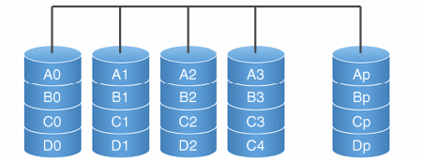
RAID 3
Block parity in additional disk.
Capacity: (N-1)*C_{disk}

Slide 93
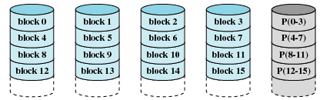
RAID 4
RAID 4: Striping + Block-level parity
Advantage: need only N+1 disks for N-disk capacity & 1 disk redundancy
Disadvantage: small writes (less than one stripe) may require 2 reads & 2 writes
  Read old data, read old parity, write new data, compute & write new parity
  Parity disk can become bottleneck

Slide 94
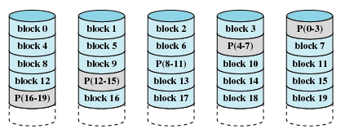
RAID 5
RAID 5: Striping + Block-level Distributed Parity
Like RAID 4, but avoids parity disk bottleneck
Get read latency advantage like RAID 0
Best large read & large write performance
Only remaining disadvantage is small writes
  “small write penalty”

Slide 95
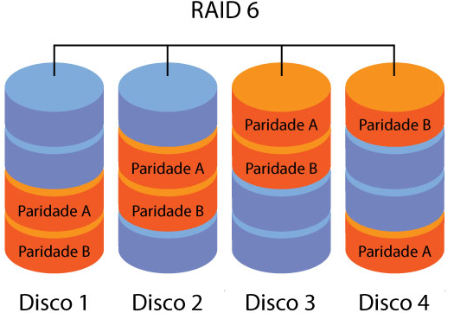
RAID 6
RAID 6: Striping + Double Block-level Distributed Parity
Like RAID 5, but doubles parity control
Allows recover from two disks failures.
Capacity = (N-2) C_{disk}

Slide 96
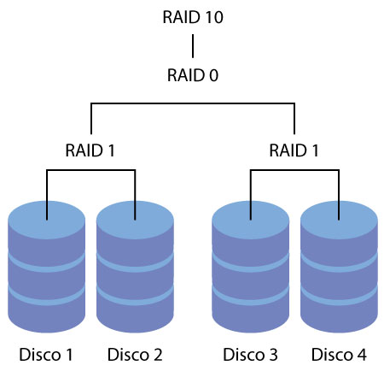
RAID 10 ou RAID 1+0

Slide 97
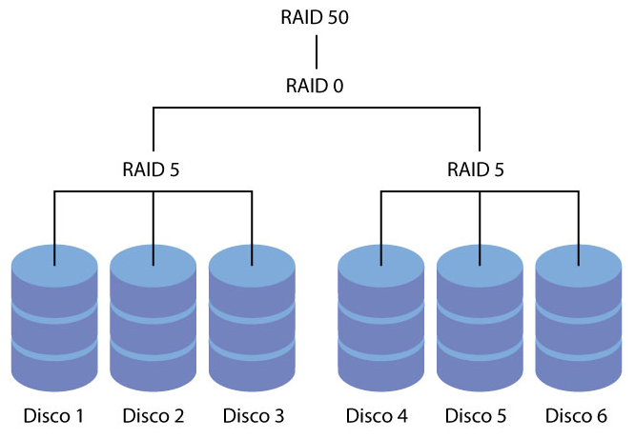
RAID 50 ou RAID 5+0

Slide 98
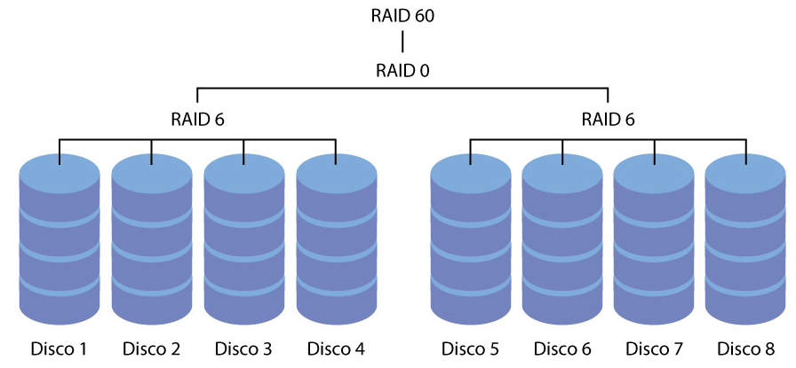
RAID 60 ou RAID 6+0
10/15/20

Slide 99
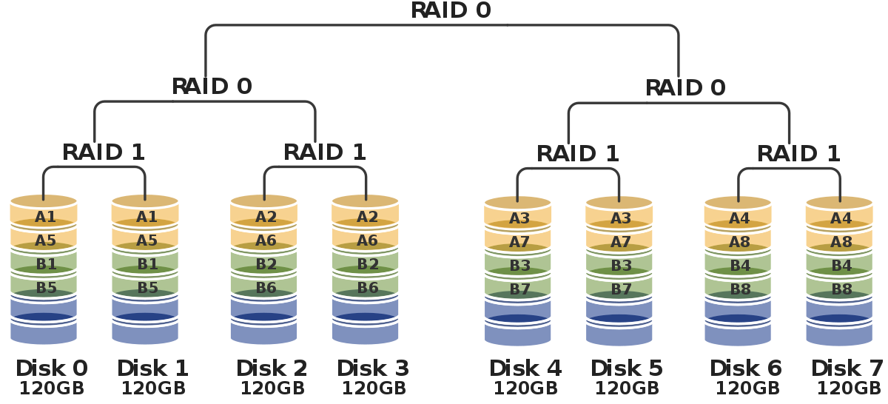
RAID 100

Slide 100
Other RAID Combinations
RAID-6: dual parity, code-based, provides additional redundancy (2 disks may fail before data loss)
RAID (0+1) and RAID (1+0):
  Mirroring+striping
10/15/20

Slide 101
Linux file structure

Slide 102
Structure of the File System
A file system defines a hierarchical structure that can be depicted in the form of a tree.
Tree is not limited to a local partition.
  Can stretch over several partitions, which can be located on different computers in a network.
  Begins at the root.
A file in the tree is uniquely defined by its path.
Path refers to the directory names that lead to a file.
    Relative path
Absolute path

Slide 103
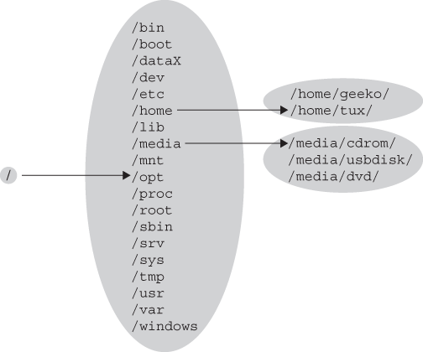
Linux hierarchical file system

Slide 104
FHS (Filesystem Hierarchy Standard)
The structure of the file system is described in the Filesystem Hierarchy Standard (FHS).
The FHS defines a two-layered hierarchy:
    - The top layer (contents of the root directory ‘‘/’’)
    - A second layer (contents under /usr and /var)

Slide 105
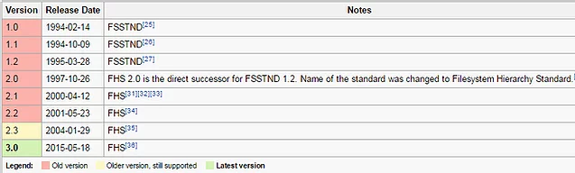
FSSTND → FHS
FSSTND : Filesystem standard
FHS: Filesystem Hierarchy Standard

Slide 106
Root Directory (/)
The root directory is the highest layer of the file system tree.
  Normally only directories (not files) are located here.
When the system is booted, the partition on which this directory is located is the first one mounted.
The following directories always have to be on the same partition as the root directory:
  /bin, /dev, /etc, /lib, and /sbin
  Includes all files required for basic operation.

Slide 107
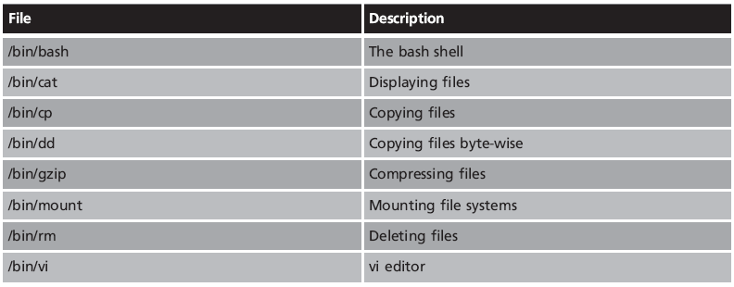
/bin
Essential Binaries
For Use by All Users.
Contains executable programs that are required when no other file systems are mounted.

Slide 108
/boot
Boot Directory.
Mount point of boot partition.
Contains static files of the boot loader.
Contains the initrd image.
Contains the Kernel:
  Kernel binary: vmlinuz*
  Kernel configuration: config*
  Kernel symbol map: System.map*

Slide 109
/dev
Each hardware component existing in the system is represented as a file in the /dev directory.
Two kinds of device files are included:
  Character-oriented device files
  Block-oriented device files
Major device numbers
  Connection to device drivers in the kernel is implemented via numbered channels
    Corresponding to the number of the device driver in question

Slide 110
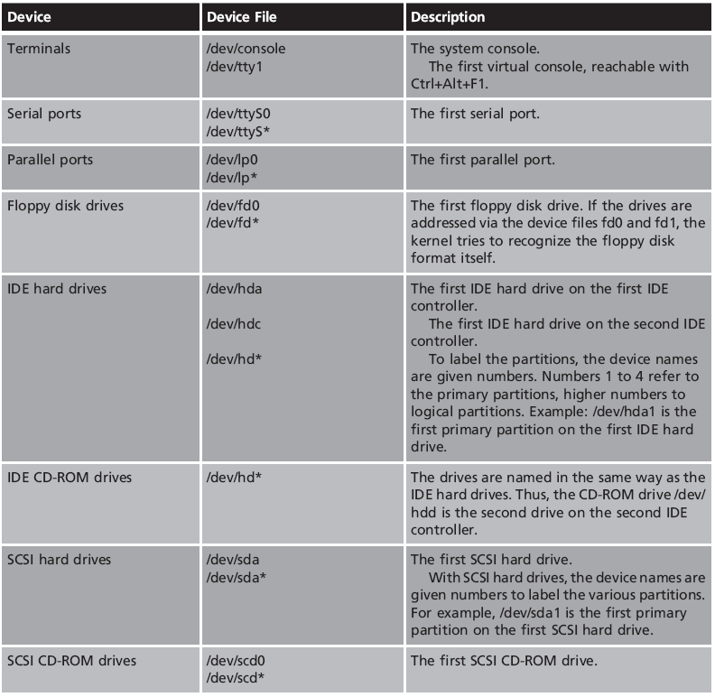
/dev

Slide 111
/etc
Configuration Files
Contains system configuration files.
  Usually text files.
Normal users can read nearly all of these files, but they cannot edit any of them.
  According to the FHS, no executable programs can be located here
  Subdirectories may contain shell scripts

Slide 112
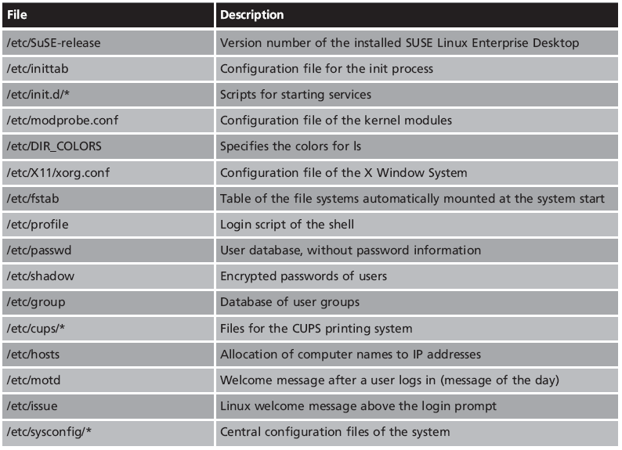
/etc

Slide 113
/home
Home directory.
Contains User Directories.
  Every user has his own area.
  Each user directory stores:
    Personal data files.
    Individual configuration files.
  Individual configuration files may be hidden using a dot prefix.

Slide 114
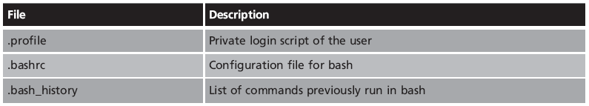
/home/username

Slide 115
/lib
Libraries
Functions that may be used by several programs:
  lib*.a lib*.so ...
Contains the libraries that are used by programs in the root filesystem:
  /bin /sbin …
Kernel modules are located at /lib/modules/

Slide 116
/media
Mountpoints for Removable Media
Dynamically created directories:
  /media/floppy/—Created for a floppy disk drive
  /media/cdrom/—Created for a CD-ROM drive
  /media/cdrecorder—Created for a CD burner
  /media/dvd—Created for a DVD drive
  /media/usbdisk/—Created for a USB stick
  /media/medianame—Created after inserting a labeled removable media

Slide 117
/opt
Options Directory
Installed programs can store their static files in the /opt directory
One sub-directory for each application.
Examples:
  /opt/zoom
  /opt/kathara

Slide 118
/root
Home Directory of the Administrator
Should be on the same partition as the root directory, ‘‘/’’
Only then is it guaranteed that the user root can:
  Always log in without a problem
  Have his or her own configured environment available

Slide 119
/sbin
System Binaries
Contains programs for system administration
Programs that are run by normal users are located in /bin
Programs in the /sbin directory can also, as a rule, be run by normal users
  But only to display the configured values

Slide 120
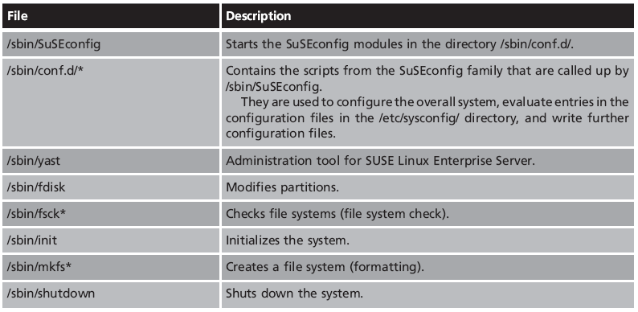
/sbin

Slide 121
/srv
Data Directories for Services
The sub-directories of the /srv directory contain data for various services.
Examples:
    Files for the Web server: /srv/www/
    FTP server files: /srv/ftp/
  Not always implemented.

Slide 122
/tmp
Temporary Area
May be mounted from volatile storage.
Readable and writable for all users.
Various programs create temporary files that are stored in /tmp until they are deleted.

Slide 123
/usr
The /usr directory, in accordance with the FHS, represents a second hierarchical layer.
This is the location for all application programs, graphical interface files, additional libraries and documentation required for normal operation.

Slide 124
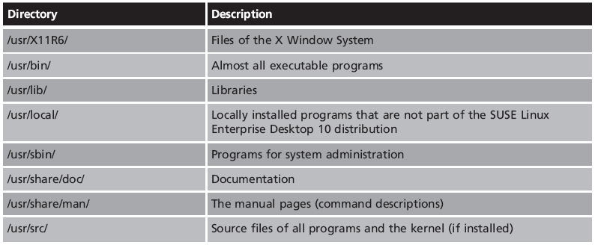
/usr

Slide 125
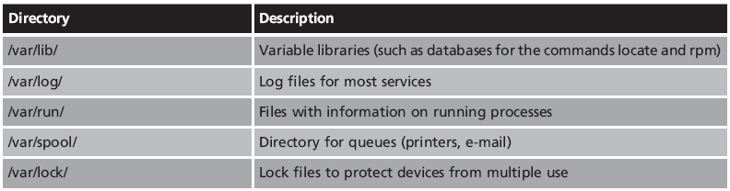
/var
Variable Files
Contains files that can be modified while the system is running

Slide 126
/proc
Process information
Information about every process.
Generated dynamically when it is accessed
  Each process has its own directory
Also includes directories and files containing information about the state of the system

Slide 127
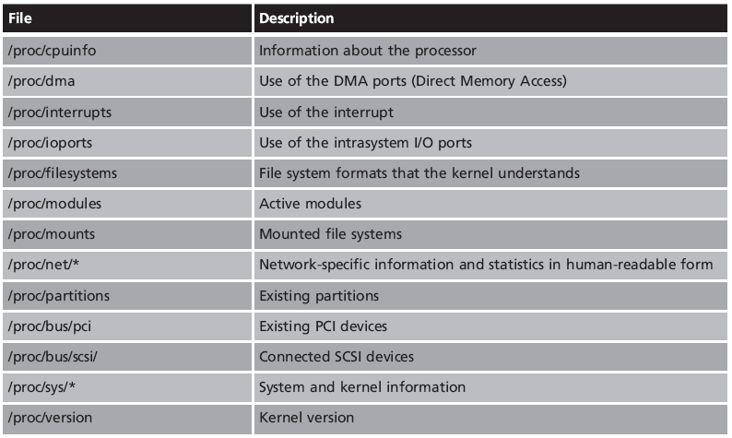
/proc

Slide 128
/sys
System Information Directory
Provides information on hardware devices.
hardware buses,
active devices,
device drivers
Like the /proc directory, /sys is generated dynamically when it is accessed

Slide 129
/mnt
Mountpoint for Temporarily Mounted File Systems
Should only be used for temporary purposes
  For permanent mounts, an appropriately named directory should be used

Slide 130
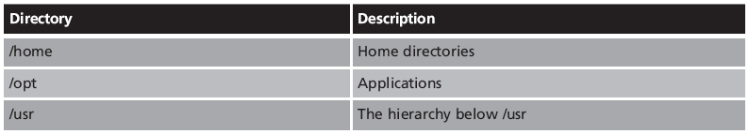
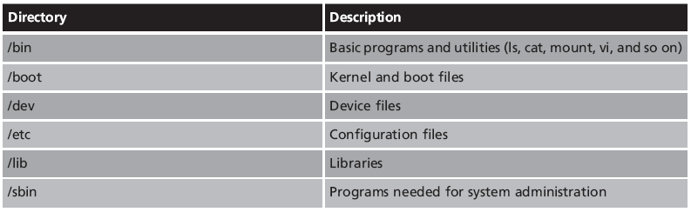
Directories from root dir

Slide 131
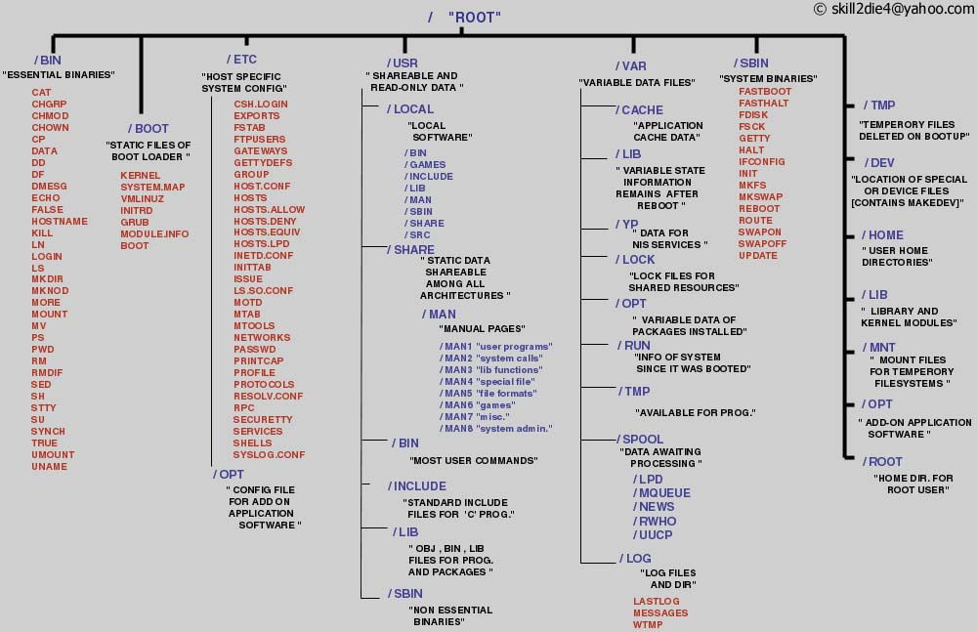
Linux files structure

Slide 133
FSSTND : (Filesystem standard)
All directories are grouped under the root entry "/"
root - The home directory for the root user
home - Contains the user's home directories along with directories for services
  ftp
  HTTP
  samba
mnt - Mount points for temporary mounts by the system administrator.
tmp - Temporary files. Programs running after bootup should use /var/tmp

Slide 134
FSSTND : (Filesystem standard)
bin - Commands needed during booting up that might be needed by normal users
sbin - Like bin but commands are not intended for normal users. Commands run by LINUX.
proc - This filesystem is not on a disk. It is a virtual filesystem that exists in the kernels imagination which is memory
  1 - A directory with info about process number 1. Each process has a directory below proc.

Slide 135
FSSTND : (Filesystem standard)
usr - Contains all commands, libraries, man pages, games and static files for normal operation.
  bin - Almost all user commands. Some commands are in /bin or /usr/local/bin.
  sbin - System admin commands not needed on the root filesystem. e.g., most server programs.
  include - Header files for the C programming language.
  lib - Unchanging data files for programs and subsystems
  local - The place for locally installed software and other files.
  man - Manual pages
  info - Info documents
  doc - Documentation
  tmp
  X11R6 - The X windows system files. There is a directory similar to usr below this directory.
  X386 - Like X11R6 but for X11 release 5

Slide 136
FSSTND : (Filesystem standard)
boot - Files used by the bootstrap loader, LILO. Kernel images are often kept here.
lib - Shared libraries needed by the programs on the root filesystem
modules - Loadable kernel modules, especially those needed to boot the system after disasters.
dev - Device files
etc - Configuration files specific to the machine.
skel - When a home directory is created it is initialized with files from this directory
sysconfig - Files that configure the linux system for devices.

Slide 137
FSSTND : (Filesystem standard)
var - Contains files that change for mail, news, printers log files, man pages, temp files
  file
  lib - Files that change while the system is running normally
  local - Variable data for programs installed in /usr/local.
  lock - Lock files. Used by a program to indicate it is using a particular device or file
  log - Log files from programs such as login and syslog which logs all logins and logouts.
  run - Files that contain information about the system that is valid until the system is next booted
  spool - Directories for mail, printer spools, news and other spooled work.
  tmp - Temporary files that are large or need to exist for longer than they should in /tmp.
  catman - A cache for man pages that are formatted on demand

Slide 138
References
http://www-128.ibm.com/developerworks/linux/library/l-linuxboot/
http://yolinux.com/TUTORIALS/LinuxTutorialInitProcess.html
http://www.pycs.net/lateral/stories/23.html
http://www.secguru.com/files/linux_file_structure
http://en.wikipedia.org/
http://www.comptechdoc.org/os/linux/commands/linux_crfilest.html

Slide 140
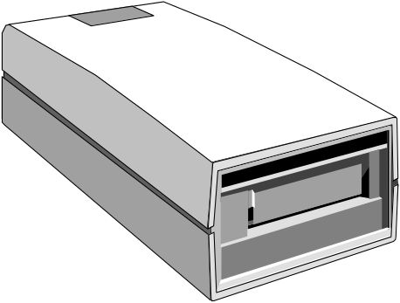
Tape Device Names
Tape devices are kept in /dev/
  device names are usually simple numbers
By default tapes rewind after writing
  tapes are not rewound before use but after
  device names ending or beginning in n will not rewind after use
None SVR4 systems use other conventions
  SCSI tape devices begin with st and nst
  Can be accessed in modes a, l, m for dencity
  Tapes are managed by mt command
# cd /
# echo "Filesystem: /etc\nDate: `date`" | dd of=/dev/nst0
# find etc -print | cpio -ocv >/dev/st0
# dd if=/dev/nst0
# cpio -itvc </dev/st0
Notes:
Magnetic tape device names are the most diverse of the naming conventions. The one common factor is to include r or nr in the name to indicate rewind or no rewind devices.
The example on the slide shows how a simple tape labelling mechanism can be provided using non rewind tape operations.

Slide 142
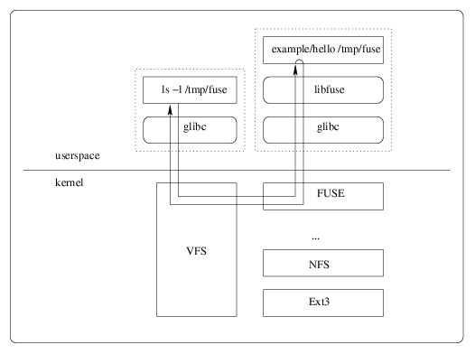
LINUX Filesystem under User Space (FUSE)
FUSE under VFS useable by ordinary users.
Commands: fusermount, funionfs, sshfs

Slide 143
Other mount options
mount –bind and mount –rbind can act as a “single directory” unionfs. That is you can re-mount a portion of a file system at another mountpoint. This is not supported on all UNIX versions. These can be made permanent in /etc/fstab.
Examples:
mount --bind olddir newdir
mount --rbind olddir newdir includes submounts
mount --move olddir newdir move a mountpoint.
• Labeled mounts: you can mount a device by a label.
First label the device: e2label /dev/sda /home
Add to /etc/fstab: LABEL=/home /home ext3 defaults 1 2
Also uses: mount L+ option
• See manpage for mount for other options.

Slide 144
What happens during the Formatting?
OS creates four tables in the 1st sectors
  Boot Record – the name & version number of the OS, info. on the physical characteristics of the disk
  Master File Table #1- keeps track of
    Available clusters
    Clusters that contain data
    Clusters that are defective
    Clusters that contain OS files
  Master File Table #2 – copy of MFT #1
  Directory Table – top level folder and file information

Slide 145
When you format a disk the operating systems creates concentric recording bands, called tracks, around the circumference of the disk. Then, the formatting program (in our case Windows XP) subdivides each track into equal parts, called sectors. Although not all of them are shown in the following diagram, there are 80 concentric tracks on a 3 ½ inch high density diskette and each track is divided into 18 sectors. Each sector in turn contains 512 bytes.
So let’s see . . . . . 80 tracks X 18 sectors X 2 sides X 512 bytes = 1,474,560 bytes = 1.4 MB

Slide 146
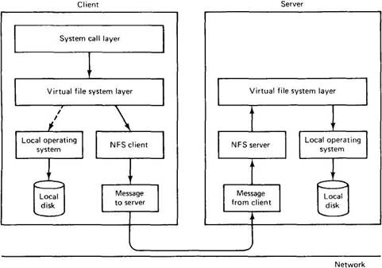
NFS

Slide 147
Boot

Slide 148
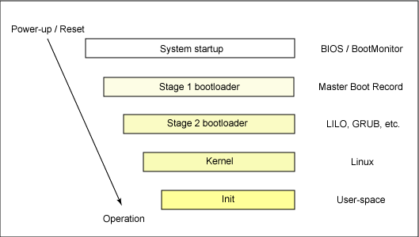
How OS boots

Slide 149
Booting sequence
Turn on
CPU jump to address of BIOS (0xFFFF0)
BIOS runs POST (Power-On Self Test)
Find bootable devices
Loads and execute boot code from MBR
Select boot partition
Load and execute boot code from partition’s boot sector
Load OS

Slide 150
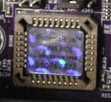
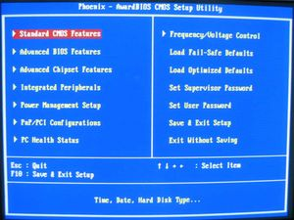
BIOS (Basic Input/Output System)
BIOS refers to the software code run by a computer when first powered on
The primary function of BIOS is code program embedded on a chip that recognizes and controls various devices that make up the computer.
BIOS on board
BIOS setup program

Slide 151
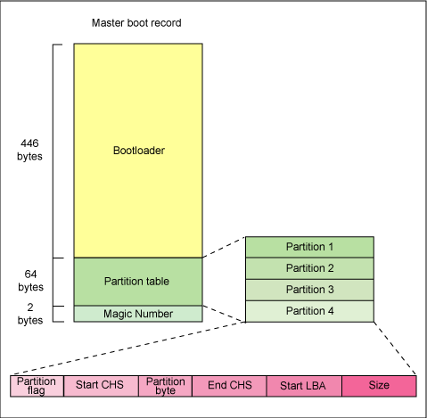
MBR (Master Boot Record)
The first 446 bytes are the primary boot loader, which contains both executable code and error message text.
The next sixty-four bytes are the partition table, which contains a record for each of four partitions.
The MBR ends with two bytes that are defined as the magic number (0xAA55). The magic number serves as a validation check of the MBR

Slide 152
MBR (Master Boot Record)
The MBR is a 512-byte sector, located in the first sector on the disk (sector 1 of cylinder 0, head 0)
MBR is loaded into RAM, address 0x07c00
the BIOS yields control to it (JUMP 0x7c00).
Usually, the BIOS or the MBR Boot Loader,
  Reads the Partition Table
  Selects the boot partition (first partition marked as bootable)
  Loads the Boot Sector of the Boot Partition into RAM,
  yields control to it (JUMP)

Slide 153
Extracting the MBR
To see the contents of MBR, use this command:
  # dd if=/dev/hda of=mbr.bin bs=512 count=1
  # od -xa mbr.bin
**The dd command, reads the first 512 bytes from /dev/hda (the first IDE drive) and writes them to the mbr.bin file.
**The od command prints the binary file in hex and ASCII formats.

Slide 154
Boot Sector
The first sector of boot partition is called:
  Boot Sector, Boot Record or Partition Boot Sector
The Boot Sector ends with two bytes that are defined as the magic number (0xAA55). The magic number serves as a validation check of the Boot Sector
Can store a boot code or a Boot Loader

Slide 155
BIOS Firmware
De-facto boot firmware standard
Used to boot PCs for the last 25+ years
  All PC like machines include BIOS firmware
BIOS is a real mode environment
  16-bit real-mode interfaces
BIOS has limitations
  Documentation is scattered
  Difficult support for new devices
  Implementations are not always consistent
  16-bit real mode

Slide 156

EFI
EFI: Extended Firmware Interface
Intel, 1998 (with contributions from Microsoft)
Designed as a BIOS replacement
Aims to avoid BIOS limitations
    Runs in native processor mode
    Can be programmed in C/C++
    More accessible than BIOS
Well documented.
Architecture is modular and extensible

Slide 157

UEFI
UEFI : Unified EFI
UEFI Forum, established in 2005
UEFI superseded EFI v1.1.
UEFI version 2.0 published in February 2006
UEFI 2.3.1 defines secure boot
  Optional mode to allow booting only signed OSs
UEFI provides a shell environment
Specific support for 32-bit and 64-bit OSs.
Defines CSM (Compatibility Support Module) for MBR booting.

Slide 158
UEFI booting
Boot Manager (in ROM) checks boot configuration in setup NVRAM.
Required drivers may be loaded.
An EFI System Partition (ESP) is selected.
The FAT filesystem from ESP is mounted as /
The file /EFI/BOOT/BOOT<xxx>.EFI is used as OS loader.
OS loader is loaded and run.
Most Linux OSs mount ESP on /boot/efi

Slide 159
UEFI Driver Model
Structured model of device/bus hierarchy
  Device Drivers
  Bus Drivers
Driver Binding Protocol
  Matches drivers to devices
  Provides flexibility
  Driver version management
  Hot-plug and unload support
Drivers not tied to FLASH
  Can be loaded from UEFI System Partition
Notes:
EFI / Framework Training Handout
November 8, 2005
Extensible Firmware Interface (EFI) Overview
More about the UEFI Driver Model -
T he Extensible Firmware Interface (EFI) provides a driver model for support of devices that attach to today’s industry-standard buses, such as PCI and USB, and architectures of tomorrow. The EFI Driver Model is intended to simplify the design and implementation of device drivers, and produce small executable image sizes. As a result, some complexity has been moved into bus drivers and to a greater extent into common firmware services. A device driver needs to produce a Driver Binding Protocol on the same image handle on which the driver was loaded. It then waits for the system firmware to connect the driver to a controller. When that occurs, the device driver is responsible for producing a protocol on the controller’s device handle that abstracts the I/O operations that the controller supports. A bus driver performs these exact same tasks. In addition, a bus driver is also responsible for discovering any child controllers on the bus, and creating a device handle for each child controller found.
The combination of firmware services, bus drivers, and device drivers in any given platform is likely to be produced by a wide variety of vendors including OEMs, IBVs, and IHVs. These different components from different vendors are required to work together to produce a protocol for an I/O device than can be used to boot an UEFI compliant operating system. As a result, the understanding of the UEFI Driver Model is needed in order to increase the interoperability of these components.
There is a structured model for dealing with hierarchies – there are two classes of drivers
Device drivers and Bus Drivers
Device drivers are topology agnostic- which means they do not really care what the platform hardware looks like – they do not care if your platform is mobile, desktop, or the biggest server you could imagine – they are just going to work.
The Benefits we get from such a model we end up with much simpler device drivers because there is less work for them to do – there is a lot more determinism because we made it the platform that select what drivers or ROMs that control what devices
In the old days the ROMs would just run and they did not know what was happening so sometimes they would just try and invent their own policy in the ROMs and you could run into situations where ROMs from different companies or even different versions of ROMs from the same company would start having conflicts because there was not a standard way to add functionality –
so the EFI Designers tried to push the policy decisions and all the choices of what to do during the boot back into the platform because it is the person making the platform that knows best.
The person writing the option ROM has to write an option ROM that will run in thousands platforms so they are not going to make the right choice for every platform. The person writing the platform, that is the person who needs control.
Basically this multi-layer Modularity means more things “Just Work”
And more things are in control of the BIOS writer for the platform

Slide 160
Boot loader
Also called: kernel loader.
The task at this stage is to load the Linux kernel
Optional, initial RAM disk
GRUB and LILO are the most popular Linux boot loaders.
Large Boot Loaders may be split into stages.

Slide 161

Boot

Slide 162
Boot loaders
bootman
GRUB
LILO
NTLDR
XOSL
BootX
loadlin
Gujin
Boot Camp
Syslinux
GAG

Slide 163
GRUB: GRand Unified Bootloader
GRUB is an operating system independant boot loader
A multiboot software packet from GNU
Flexible command line interface
File system access
Support multiple executable format
Support diskless system
Download OS from network
Etc.

Slide 164
GRUB boot process
The BIOS finds a bootable device (hard disk) and transfers control to the master boot record
The MBR contains GRUB stage 1. Given the small size of the MBR, Stage 1 just load the next stage of GRUB
GRUB Stage 1.5 is located in the first 30 kilobytes of hard disk immediately following the MBR. Stage 1.5 loads Stage 2.
GRUB Stage 2 receives control, and displays to the user the GRUB boot menu (where the user can manually specify the boot parameters).
GRUB loads the user-selected (or default) kernel into memory and passes control on to the kernel.

Slide 165
GRUB Naming Convention
GRUB uses BIOS hard disk numbers
  Number start at 0 (zero).
  OS may use a different order.
Examples
  (hd0,0) First partition of first hard disk
  (hd1,2) Third partition of second hard disk.

Slide 166

Example GRUB config file

Slide 167
LILO: LInux LOader
Not depend on a specific file system
Can boot from harddisk and floppy
Up to 16 different images
Must change LILO when kernel image file or config file is changed

Slide 168
syslinux
Usa partições FAT
Programa de instalação:
  syslinux, em Linux
  syslinux.exe, em MS Windows
Configuração: syslinux.cfg

Slide 169


Chickend and Egg Problem
Para aceder a um sistema de ficheiros é necessário suporte para:
  Dispositivo de armazenamento
    IDE, SCSI, RAID, USB, …
  Tipo de sistema de ficheiros
    FAT, EXT4, RaiserFS, …
=> carregar módulos do SO.
módulos do SO residem no sistema de ficheiros.

Slide 170

RAM Disk

Slide 171
Booting with initrd
The bootloader passes the initrd image to the kernel.
  The bootloader loads the kernel image into memory
  The bootloader then loads an initrd image into another section of available memory.
  The passes the load address of the initrd image to the kernel before passing control to it.

Slide 172
initrd
boot=/dev/hda
map=/boot/map
install=/boot/boot.b
prompt
timeout=50
default=linux
image=/boot/vmlinuz-2.2.12-20
label=linux
initrd=/boot/initrd-2.2.12-20.img
read-only
root=/dev/hda1
ext2 fs disk image

Slide 173
FSystem on disk
Create a loopback file system
  # dd if=/dev/zero of=rootfs bs=1k count=<size>
Make file system:
  # mke2fs -N 2048 rootfs
Mount the file system
  # mount -o loop rootfs /mnt
Copy files from target workspace.
  # cp … /mnt
Unmount the file system
  # umount /mnt

Slide 174
initramfs
initramfs is a relatively new (Linux 2.6).
Conceptually similar to initrd,
Same purposes: to enable loading of drivers that might be required before mounting the real root file system.
Different implementation from the initrd.
intramfs image is packed in a compressed cpio archive.

Slide 176
Create Initrd
#!/bin/bash
# Ramdisk Constants
RDSIZE=4000
BLKSIZE=1024
# Create an empty ramdisk image
dd if=/dev/zero of=/tmp/ramdisk.img bs=$BLKSIZE count=$RDSIZE
# Make it an ext2 mountable file system
/sbin/mke2fs -F -m 0 -b $BLKSIZE /tmp/ramdisk.img $RDSIZE
# Mount it so that we can populate
mount /tmp/ramdisk.img /mnt/initrd -t ext2 -o loop=/dev/loop0
# Populate the filesystem (subdirectories)
mkdir /mnt/initrd/bin
mkdir /mnt/initrd/sys
mkdir /mnt/initrd/dev
mkdir /mnt/initrd/proc
# Grab busybox and create the symbolic links
pushd /mnt/initrd/bin
cp /usr/local/src/busybox-1.1.1/busybox .
ln -s busybox ash
ln -s busybox mount
ln -s busybox echo
ln -s busybox ls
ln -s busybox cat
ln -s busybox ps
ln -s busybox dmesg
ln -s busybox sysctl
popd
# Grab the necessary dev files
cp -a /dev/console /mnt/initrd/dev
cp -a /dev/ramdisk /mnt/initrd/dev
cp -a /dev/ram0 /mnt/initrd/dev
cp -a /dev/null /mnt/initrd/dev
cp -a /dev/tty1 /mnt/initrd/dev
cp -a /dev/tty2 /mnt/initrd/dev
# Equate sbin with bin
pushd /mnt/initrd
ln -s bin sbin
popd
# Create the init file
cat >> /mnt/initrd/linuxrc << EOF
#!/bin/ash
echo
echo "Simple initrd is active"
echo
mount -t proc /proc /proc
mount -t sysfs none /sys
/bin/ash --login
EOF
chmod +x /mnt/initrd/linuxrc
# Finish up...
umount /mnt/initrd
gzip -9 /tmp/ramdisk.img
cp /tmp/ramdisk.img.gz /boot/ramdisk.img.gz

Slide 178
Basic parted (continued)
Create a LVM partition
  Make a normal data partition
  Mark as LVM
    parted <drive-device> set <partition#> lvm on
    e.g. parted /dev/sda set 2 lvm on
    NOT parted /dev/sda2 lvm on
  Marks /dev/sda2 with "Linux LVM" GUID

Slide 179
Booting with initrd
This kernel command line defines the following kernel behavior:
  Specify a single console on device ttyS0 at 115 kilobaud
  Mount a root file system via NFS, the network file system
  Find the NFS root file system on host 192.168.1.9
    (from directory /home/chris/sandbox/omap-target)
  Load and mount an initial ramdisk from physical memory location
    0x10800000, which has a size of 0x14AF47 (1,355,591 bytes)

Slide 180
Using initramfs
The technical implementation details differ significantly between initrd and initramfs.
For example, initramfs is loaded before the call to do_basic_setup(), which provides a mechanism for loading firmware for devices before its driver has been loaded.

